Slide 1

Shiny
By R Studio
Prerequisite
Download R studio using below link or take installer file from us.
https://www.rstudio.com/products/rstudio/download/
- Few knowledge of R
By Ashwani Saxena

Slide 2
Introduction to Shiny
What is Shiny?
R Package for Interactive Web Apps developed by R Studio.
Gives the power of R in a convenient user interface
Can be written entirely in R
Shiny doesn't really require it, but as with all web programming, a little awareness of HTML, CSS and JavaScript is very helpful
HTML gives a web page structure and sectioning as well as markup instructions.
CSS describes how content is presented
JavaScript is for interactivity

Slide 3
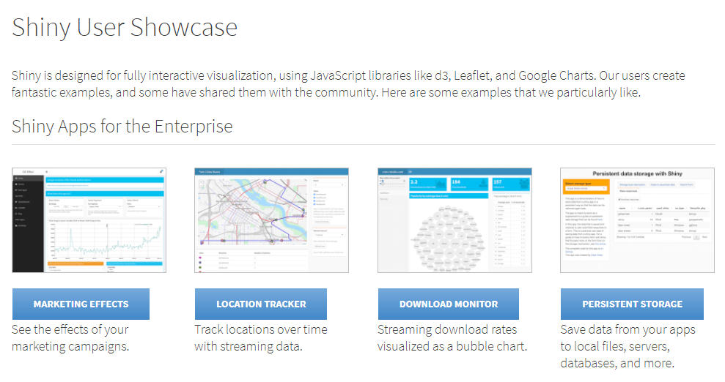
Demo Applications
https://www.rstudio.com/products/shiny/shiny-user-showcase/

Slide 4
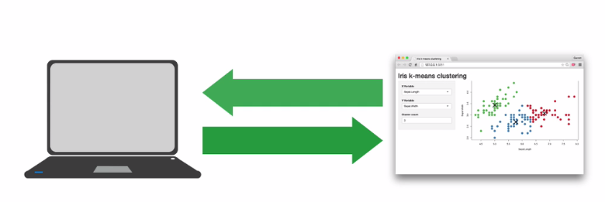
Architecture of Shiny R
Every Shiny App is maintained by computer running R

Slide 5
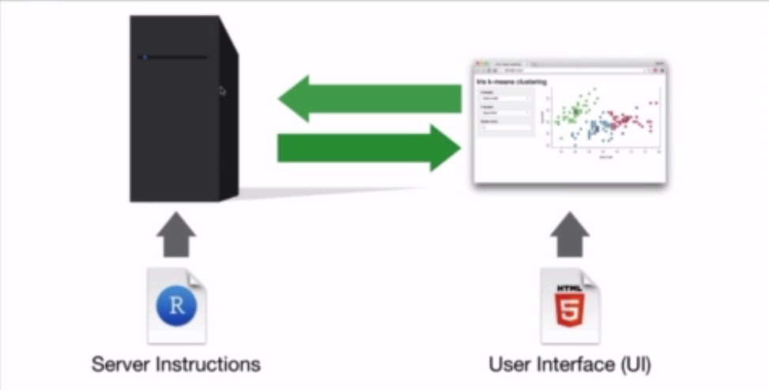
Architecture of Shiny R

Slide 6
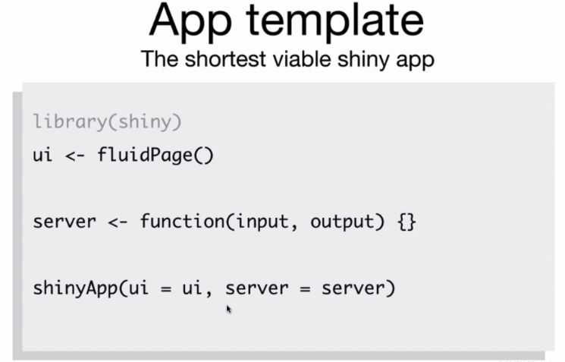

Slide 7
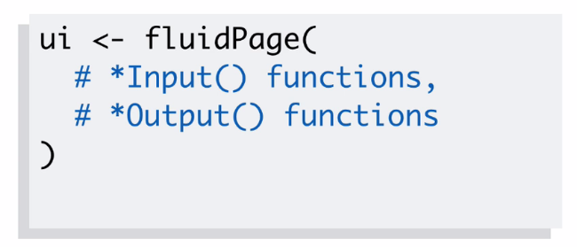
UI Template
Add elements to your app as arguments to fluidpage()

Slide 8
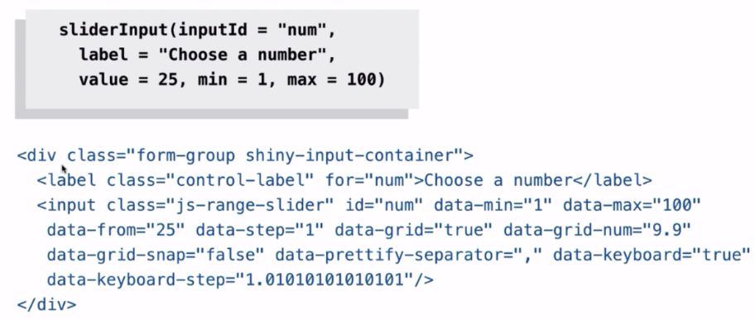
Input()
Create an input with and *Input() function

Slide 9
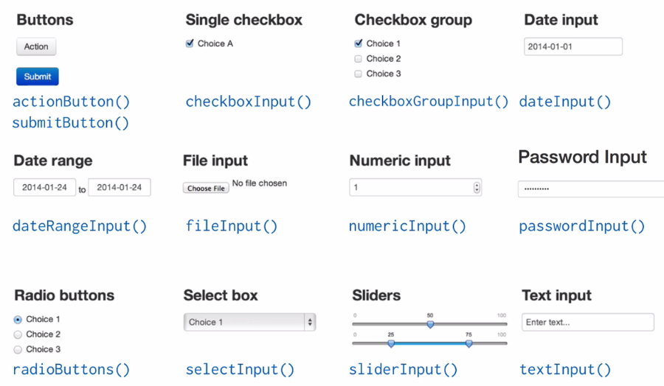
Other Input() Provided by shiny

Slide 10
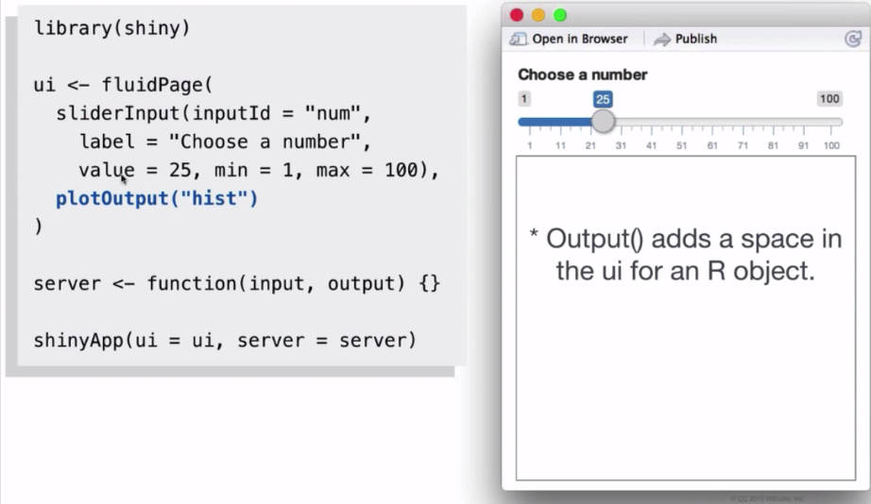
Output()

Slide 11
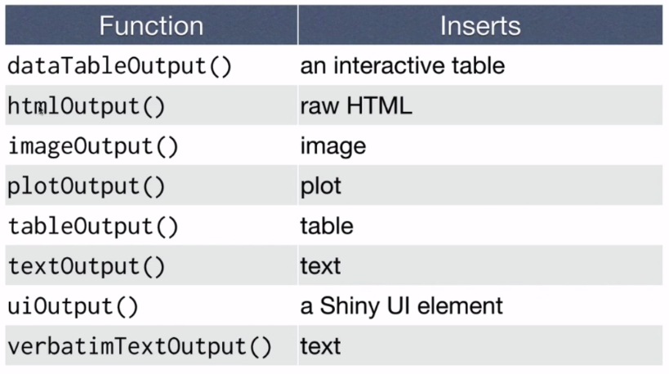
Other output() Functions

Slide 12
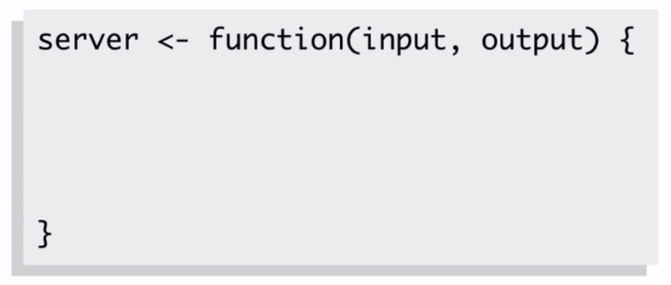
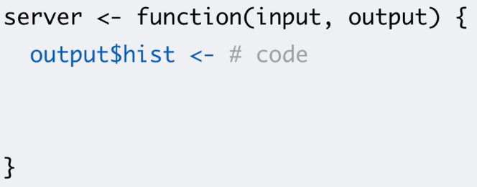
Server Template
Add elements to your app as arguments to server()
Save objects to display to output$

Slide 13
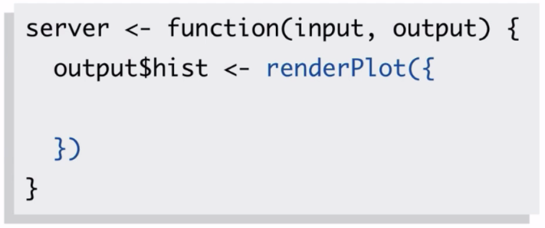
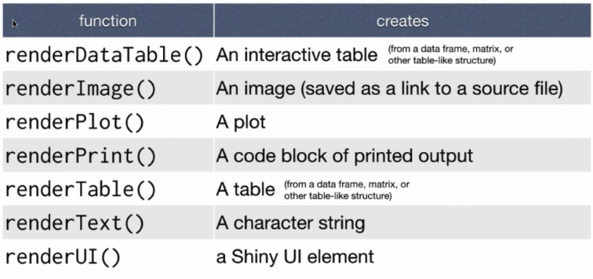
Build Objects to display with Render*()
Use any render*() that create the type of output you wish

Slide 14
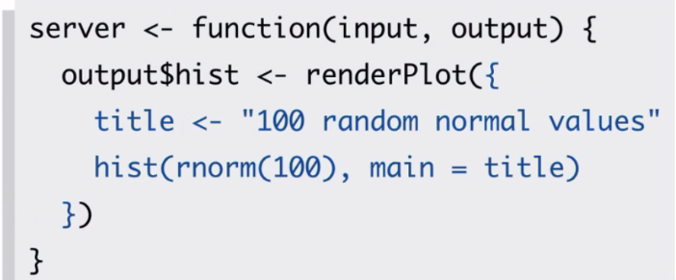
Build Objects to display with Render*()
renderPlot()

Slide 15
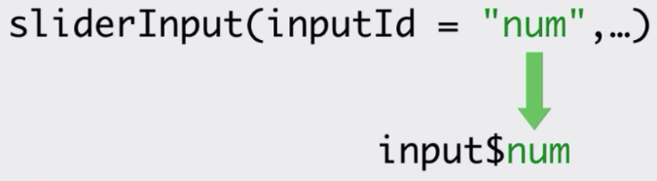
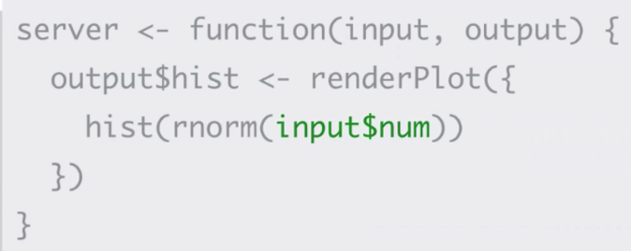
Reactivity
Use Input values with input$

Slide 16
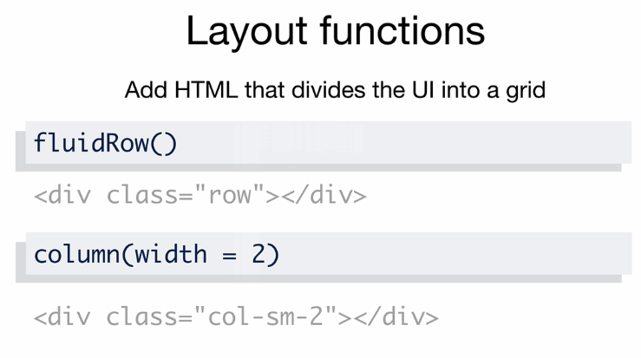
Manage layout of Shiny

Slide 17
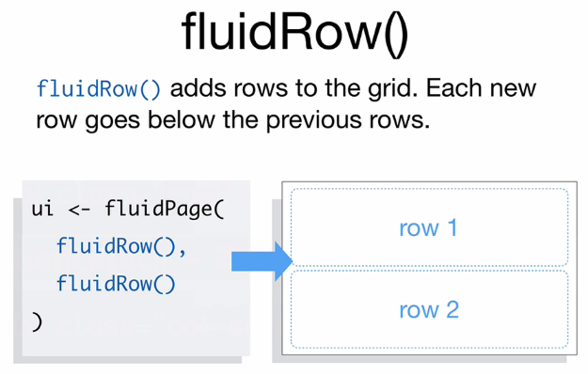
Manage layout of Shiny

Slide 18
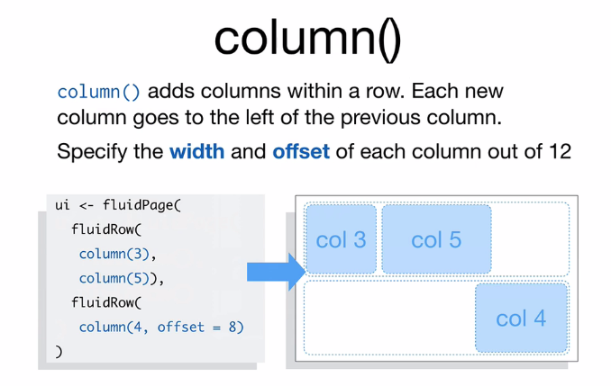
Manage layout of Shiny

Slide 19
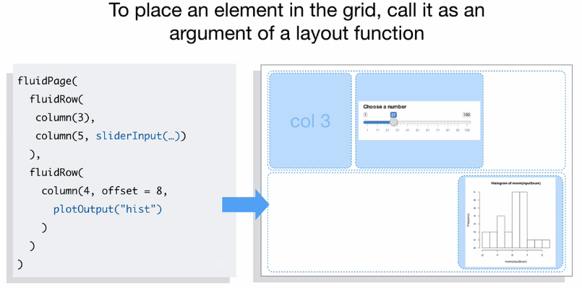
Manage layout of Shiny

Slide 20

Build basic shiny app with your own data
Lets do some practice…..

Slide 21
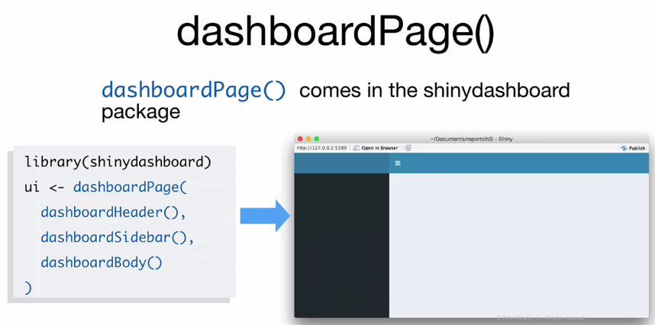
Shiny Dashboard

Slide 22
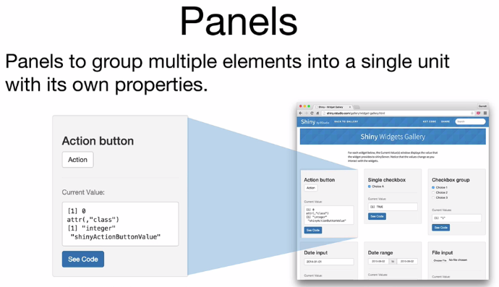
Shiny Panels

Slide 23
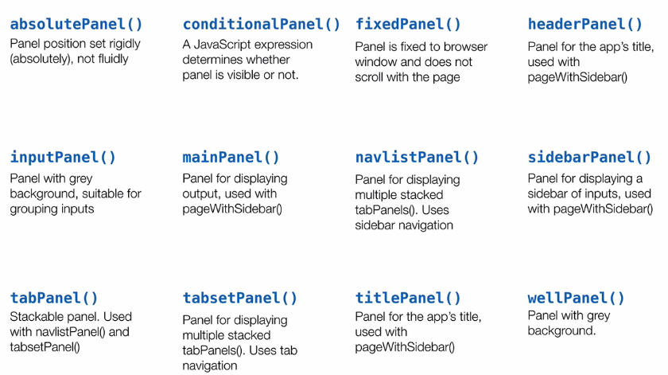
Shiny Panels

Slide 24
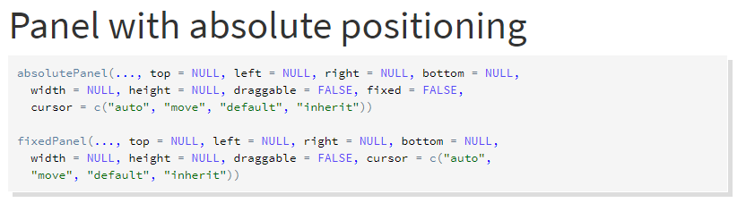
Shiny Panels
absolute( )

Slide 25
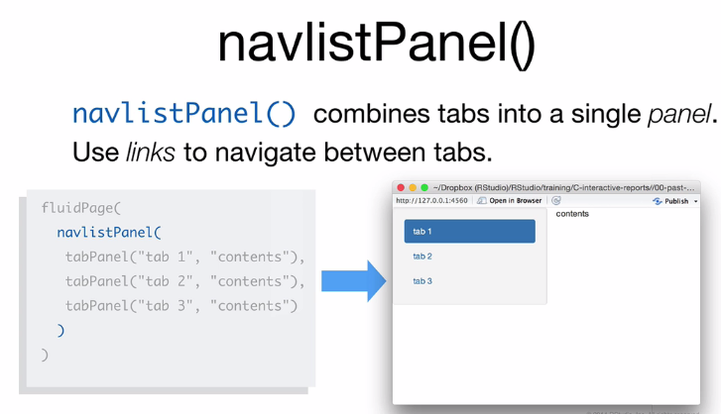
Shiny Panels

Slide 26
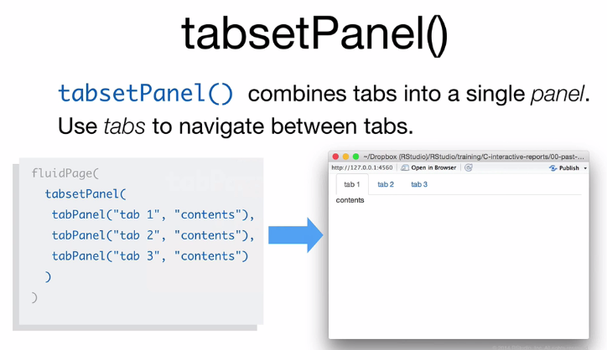
Shiny Panels

Slide 27
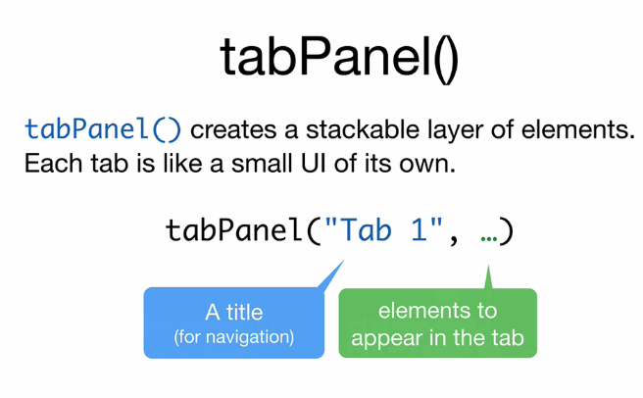
Shiny Panels

Slide 28
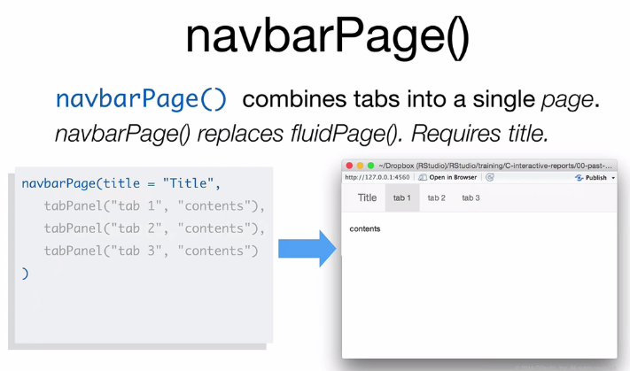
Shiny Panels

Slide 29
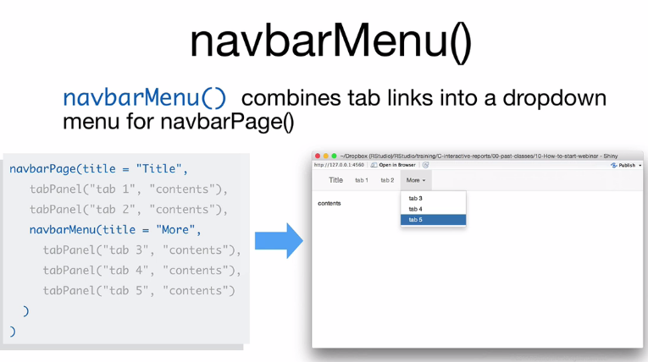
Shiny Panels

Slide 30
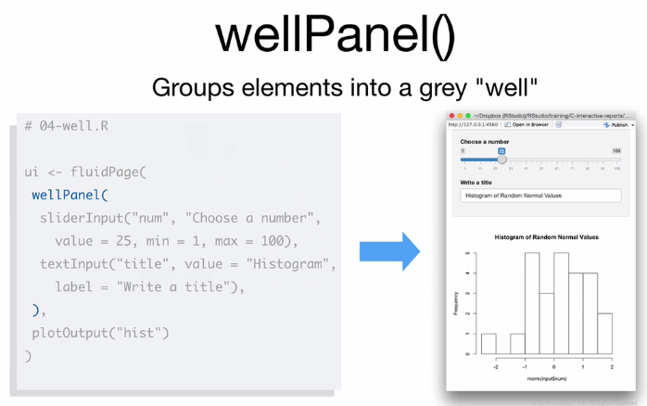
Shiny Panels

Slide 31
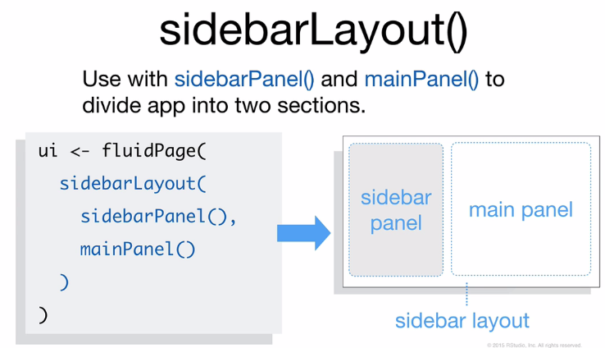
Shiny UI Layout

Slide 32
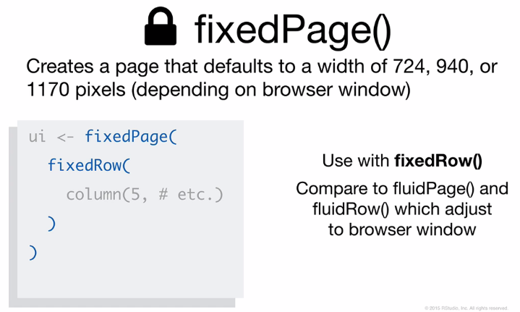
UI Layout

Slide 33
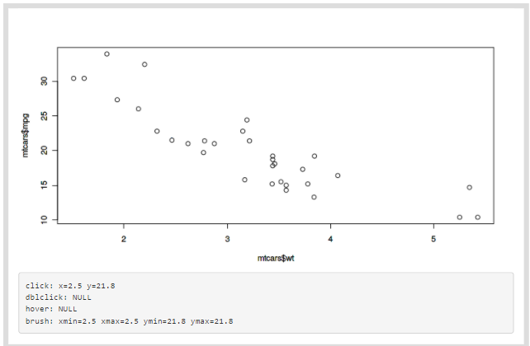
Interactivity with Plots
Subset/Select the data using
click
dblclick
hover
brushedPoints()
nearPoints()
plotOutput("plot1",
click = "plot_click",
dblclick = "plot_dblclick",
hover = "plot_hover",
brush = "plot_brush" )

Slide 34
Build Interactive shiny app with your own data
Lets do some practice…..

Slide 35
Work with the
HTML UI

Slide 36
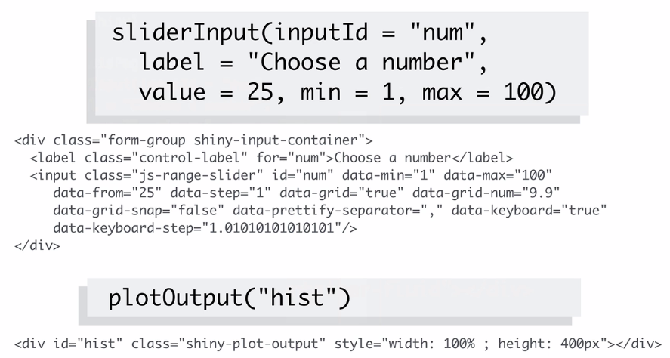
Working with HTML

Slide 37
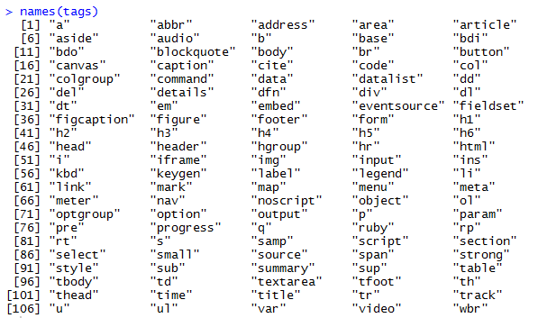
Working with HTML
Tags - Each element of the tags list is a function that recreates an html tag

Slide 38
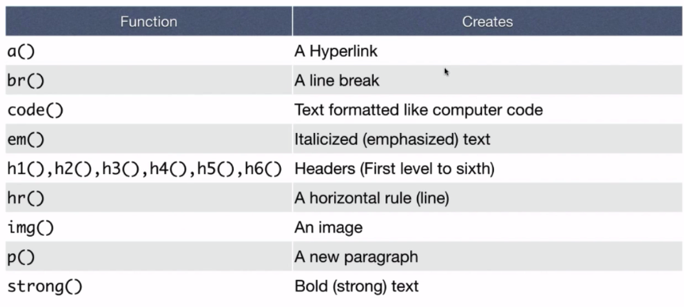
Working with HTML

Slide 39
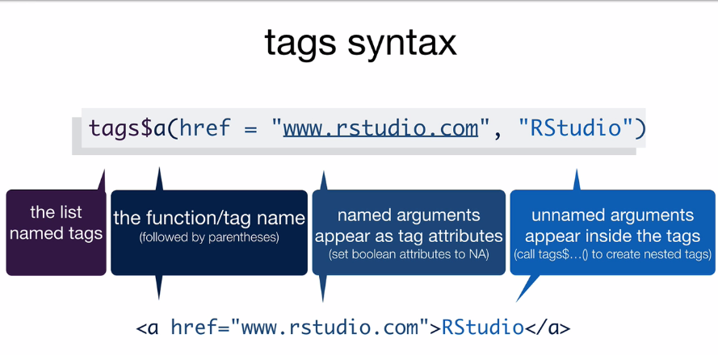
Working with HTML

Slide 40
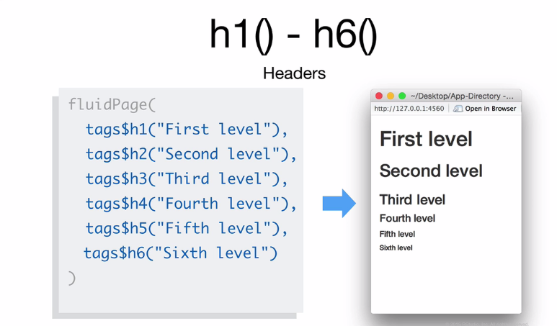
Working with HTML

Slide 41
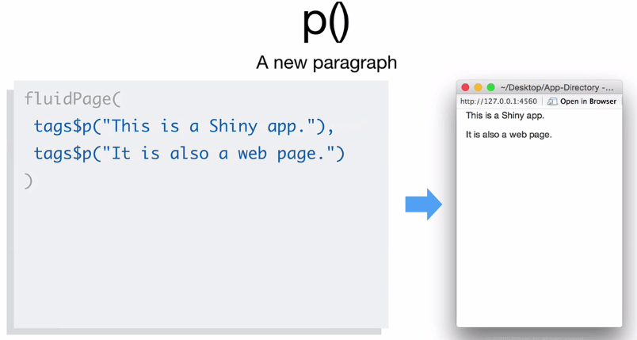
Working with HTML

Slide 42
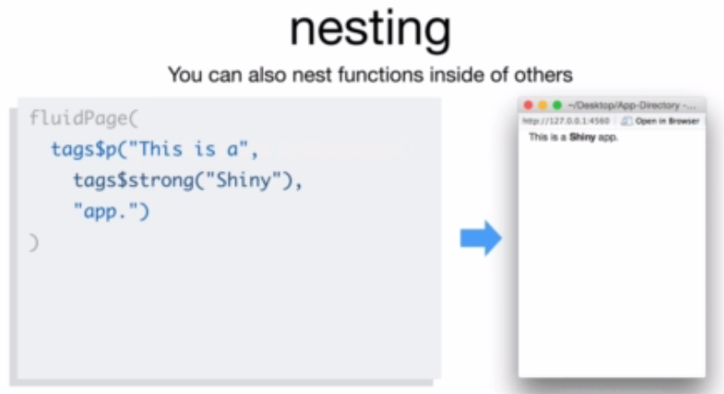
Working with HTML

Slide 43
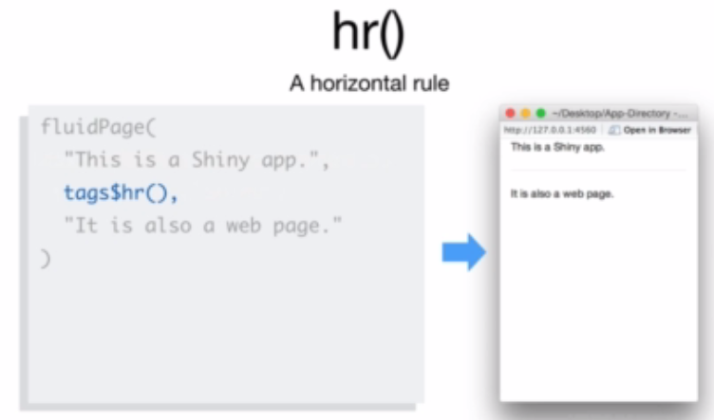
Working with HTML

Slide 44
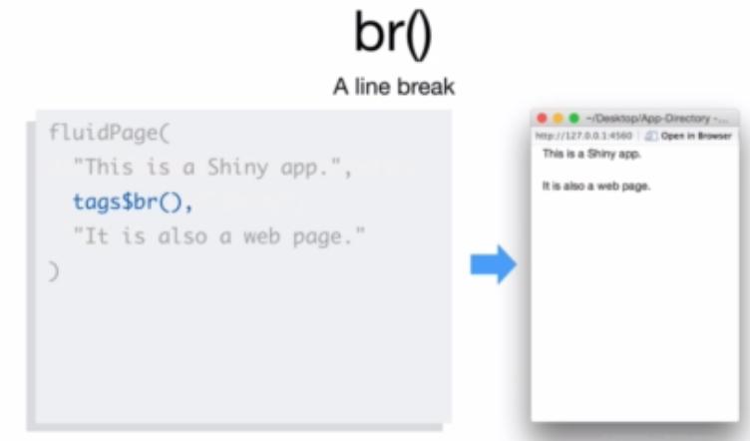
Working with HTML

Slide 45
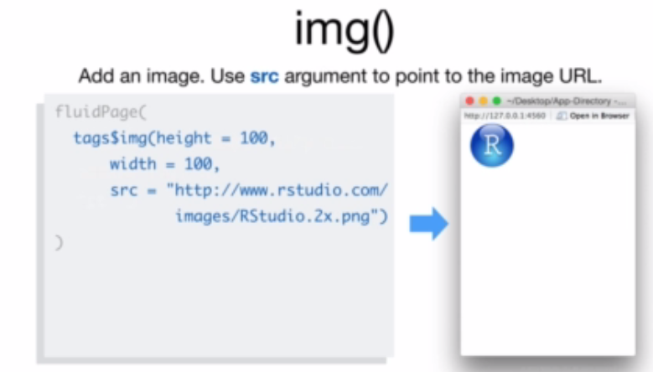
Working with HTML

Slide 46
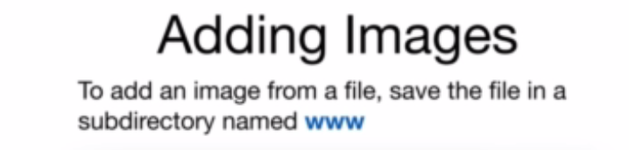
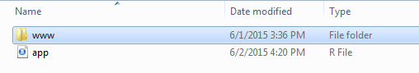
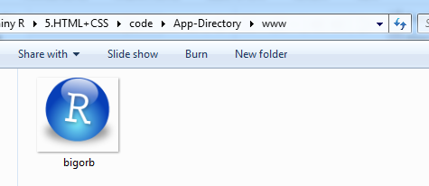
Working with HTML

Slide 47
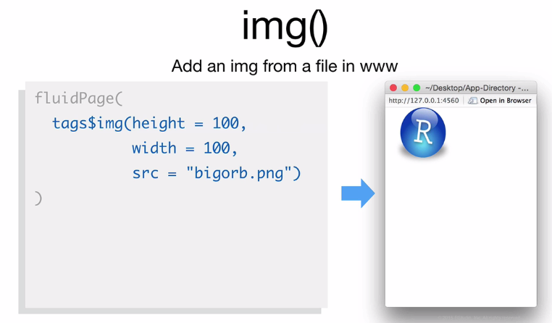
Working with HTML

Slide 48
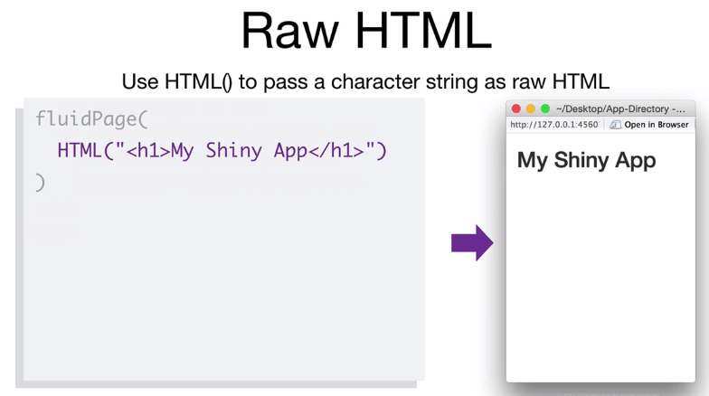
Working with HTML

Slide 49
Style with
CSSS

Slide 50
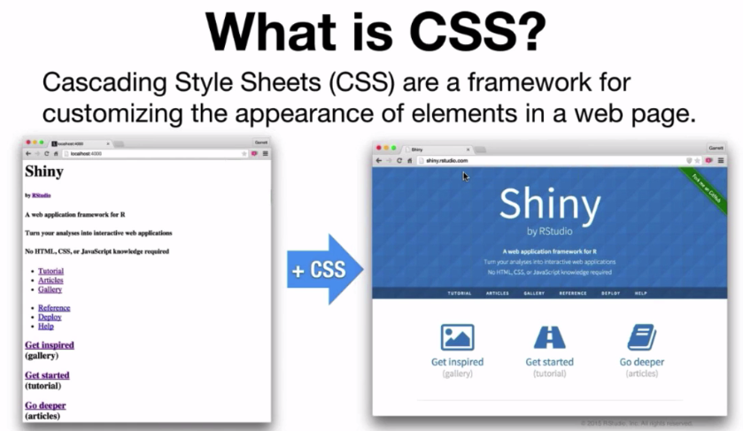
CSS in Shiny

Slide 51
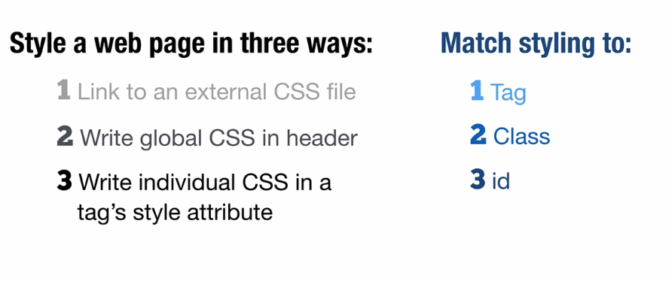
CSS in Shiny

Slide 52

CSS in Shiny

Slide 53

CSS in Shiny

Slide 54

CSS in Shiny

Slide 55

CSS in Shiny

Slide 56

CSS in Shiny

Slide 57

CSS in Shiny

Slide 58

CSS in Shiny

Slide 59

CSS in Shiny
Few Important link :
http://shiny.rstudio.com/articles/google-analytics.html
http://www.htmlwidgets.org/
http://rstudio.github.io/leaflet/
http://shiny.rstudio.com/articles/css.html

Slide 60
Sharing and deploying
Shiny App

Slide 61
Share Shiny apps
Share your apps as two R files: Server.R and Ui.R
Anyone can launch your app as long as they have a copy of R, Shiny, and a copy of your app’s files.
runUrl, runGitHub, and runGist make it simple to share and retrieve Shiny files from web links.
Share your Shiny app as a web page
You can turn your app into a live web app at its own URL with shinyapps.io.
You can use the open source Shiny Server to build a Linux server that hosts Shiny apps.
If you need closer control, or want to manage large volumes of traffic, you can purchase Shiny Server Pro from RStudio.

Slide 62
Deploying our First Shiny app
Deploy Shiny Apps using below two Method
Shinyapps.io(For more details- Please see http://docs.rstudio.com/shinyapps.io/index.html)
Shiny server(For more details- Please see http://docs.rstudio.com/shiny-server/)
Github
Shinyapps.io is an online service for hosting Shiny apps in the cloud. RStudio takes care of all of the details of hosting the app and maintaining the server
To use shinyApps.io
Install the rsconnect R package from github
Create an account at shinyapps.io
Use the tokens generated by shinyapps.io to configure your reconnect package.
Deploy apps with reconnect::deployApp
Terminate apps with rsconnect::terminateApp
You can also use shinyapps.io to create secure apps, and manage your authorized users (For Paid users).
https://saxena.shinyapps.io/vision_techno/
http://rpubs.com/ashwanis/289017
runGitHub( "training", "ashwanisa")

Slide 63
Brief Intro of
R Markdown

Slide 64

R Markdown in Shiny
R Markdown
Is a file format for making dynamic documents with R
Is written in markdown (an easy to write plain text format)
Contains chunks of R code
Source code for rich, reproducible documents
Getting Started
In RStudio, create a new R Markdown document by choosing File | New | R Markdown.
Click the Knit HTML button in the doc toolbar to preview your document.
In the preview window, click the Publish button.

Slide 65
R Markdown in Shiny
Markdown for formatted text
.Rmd files are meant to contain text written in markdown. Markdown is a set of conventions for formatting plain text. You can use markdown to indicate
bold and italic text
lists
headers (e.g., section titles)
hyperlinks
and much more

Slide 66
Thanks &
Happy Learning

